Slide 1


The first decentralized power bank service network

Slide 2



CORE TEAM MEMBER
ALEX ZHENG
Serial Entrepreneur
HKUST PhD candidate
Core member of Crypto Fintech Lab
JACK WU
Founder of 0xU Hong Kong blockchain club
HKUST MPhil student
Core member of Crypto Fintech Lab
DAVID
Mobike(us) founding team member
3+ Years Experience in Power Bank Industry
Boston University graduate
ETHAN MAO
Senior web3 developer, 3+ years experience in web3 programming
HKUST PhD candidate
Core member of Crypto Fintech Lab
DAVE DENG
Founder of cen web3 club
HKUST BSc, Bussiness School
Core Member of Hong Kong Digital Asset Society
ADVISORY BOARD
PROF. WANG
Vice president of HKUST
Chief Scientist of the Hong Kong Web3.0 Association
PROF. CHEN
Director of HKUST Crypto Fintech Lab

Slide 3
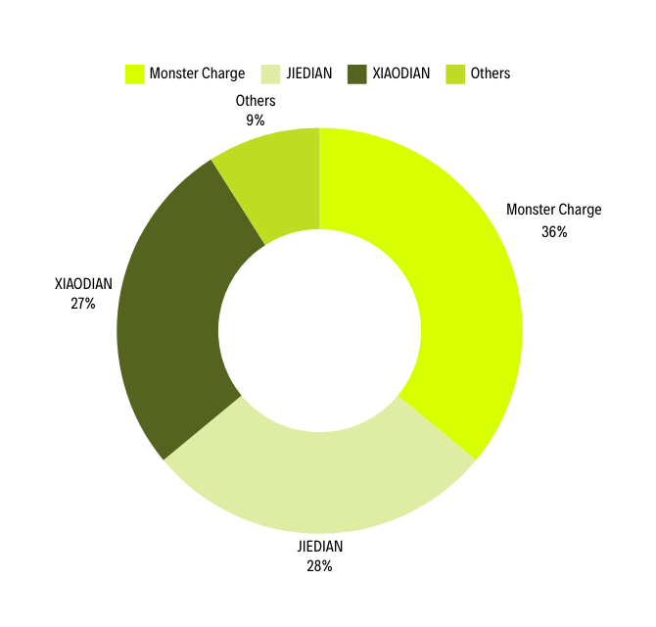
MARKET OPPORTUNITY
Market Potential and Growth Expectations for CHARGEPAL
KEY PLAYER - MONSTER CHARGE:
Market leader with about 36% market share.
Founded in 2017. Listed on NASDAQ in 2021. Raised $234 million in Series D funding.
$431 million annual revenue in 2023.
Plan to deploy 2 million power banks equipment within four years. Aim to become the market leader in the overseas market.
Primary regions include Southeast Asia and Middle East.
Expected annual revenue of approximately $1 billion.
In mainland China, power banks have become standard fixtures in stores, with over 10 million units deployed nationwide.

Slide 4
CHALLENGES AND SOLUTIONS
CURRENT OVERSEAS MARKET CHALLENGES
HOW CHARGEPAL CAN SOLVE THESE CHALLENGES
High market expansion and equipment costs.
Lack of leading companies.
Cultural, regulatory, and infrastructure issues.
Using token incentive to encourage user-driven market expansion.
Significant reduction in distribution and business development costs.
"THE BEST WAY TO EXPAND A NETWORK IS NOT TO EXPAND IT."

Slide 5

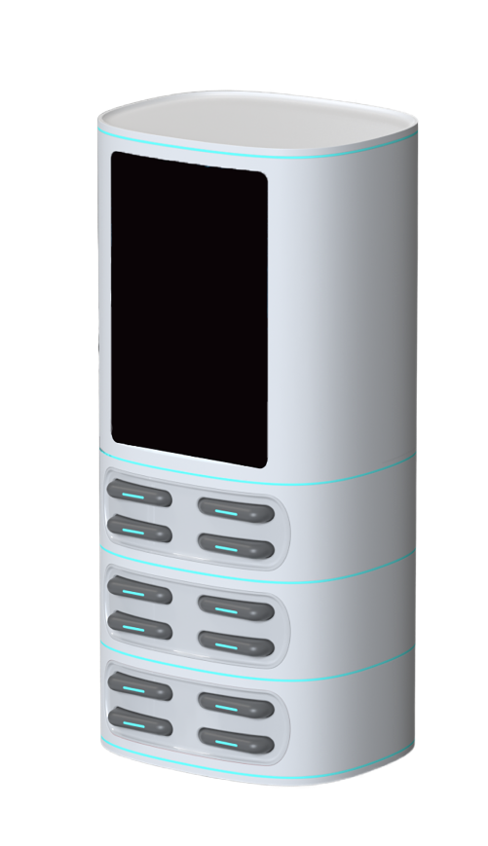
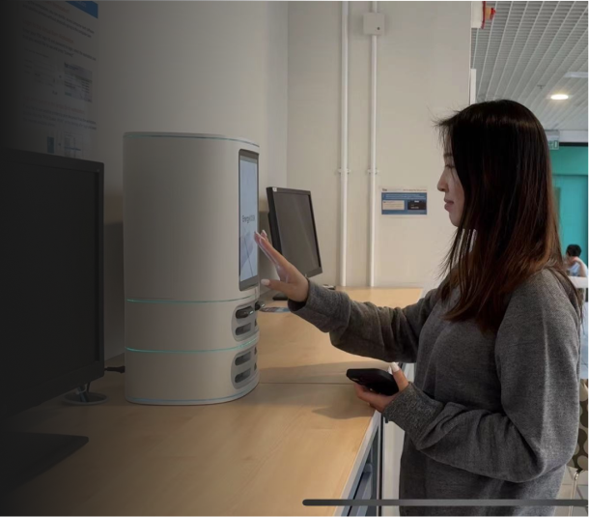
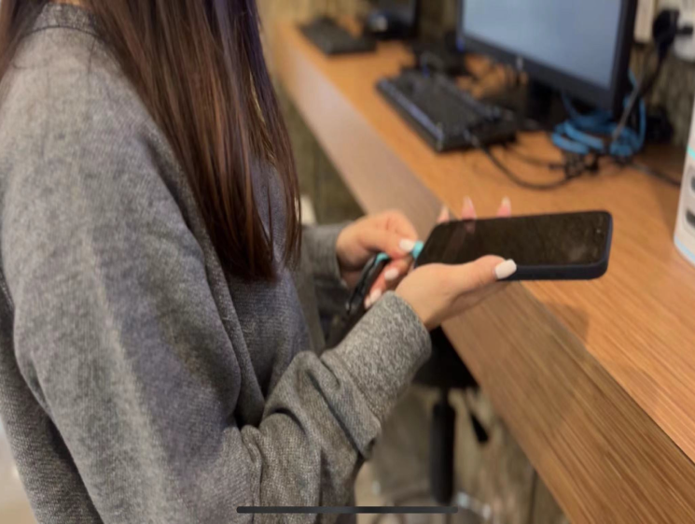
PORDUCT
Product Sample
Charge Station Placed at HKUST
(See more use process in our demo video)
CB Certification/ CE Certification

Slide 6

BUSINESS MODEL: SUPPLY AND DEMAND
Miner:
Buy the equipment
Rental income and CHAREG token
Pay with CHARGE, stablecoin or fiat.
User: Rent charge banks
CHARGEPAL
Stake CHARGE token
Agents:
Place the equipment
Validator:
Provide location proof
Agent fee and CHAREG token
CHARGE Token
Supply Side
Miners: Earn CHARGE based on usage and location of power bank stations.
Rental Share Rewards: Miners holding CHARGE tokens will receive 70% share of the rental income.
Discounted Equipment Purchase: Miners can purchase new equipment at a discounted rate using CHARGE.
Demand Side
Validator Community: Join by staking CHARGE and earn more CHARGE by providing location proofs.
Location Proofs: Users earn CHARGE for verifying equipment locations, ensuring ecosystem security.

Slide 7
BUSINESS MODEL: AGENTS
AGENTS:
Traditional Agents:
Buy and place the equipment
Direct Revenue Sharing: CHARGEPAL: 15%; Agents: 85%.
Mining Output: Aligned with Web3 miners with a 15% coefficient.
CHARGEPAL
Web3 Agents:
Place the equipment
Revenue: Agent fee and CHARGE token Incentive
SUMMARY
CHARGE Consumption
Burn CHARGE to use power banks.
Pay CHARGE to buy the equipment.
Stake CHARGE to join validator community
CHARGE Acquisition
Purchase equipment to receive CHARGE tokens.
Use power banks and provide location proof to earn CHARGE tokens.

Slide 8
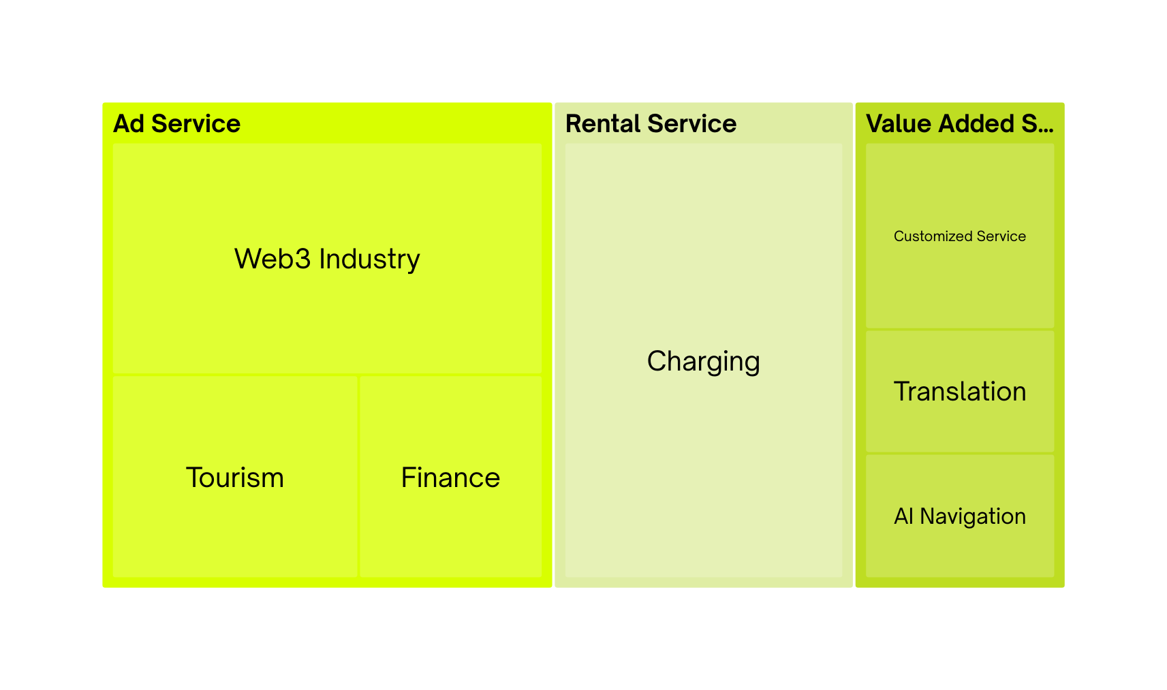
REVENUE MODEL

Slide 9


ECOSYSTEM COOPERATION
EQUIPMENT ACQUISITION THROUGH OLINE PLATFORM
INTEGRATION WITH TG MINI APP
DEPOSIT-FREE USAGE VIA $Charge STAKING:
Online selling with ETH and USDT. The buyers don’t need to warry about where to place the equipment.
Users can access ChargePal power banks through the TG Mini APP.
Encourages payments using the telegram wallet app or Metamask for seamless transactions.
@chargepal_bot
Users can stake $Charge to ChargePal to qualify for deposit-free power bank usage.
Staking $Charge grants users a certain number of free uses.
EQUIPMENT
ETH/USDT

Slide 10


ADVANTAGE
1
Validated Business Model: The power bank industry has a proven business model, and the demand for shared power bank is real, reducing investment risk.
2
Robust Cash Flow: Our business model ensures scaling with minimal capital requirements.
3
DePIN collaboration: Our platform will be launched on Telegram as a mini app, which will bring our product to 1 billion users worldwide easily. We will also collaborate with many DePIN projects to expand our business further.

Slide 11
ROADMAP
2024 Q3
TESTNET Launch
2025 Q2
50,000 Service Nodes
Engage Web2 Agents
2026
Engage More offline Agents and
Power Bank Operators.
2024 Q4
5,000 Service Nodes
500,000 Users Worldwide
Mainnet Launch
TGE
2025 Q4
100,000 Service Nodes
Build Ecosystem

Slide 12
CONTACT US
Email: contact@chargepal.xyz
Telegram Community: https://t.me/+neuxVLLUJ19lNTZl
Twitter: @Chargepalweb3
Website: www.chargepal.xyz

